Slide 1
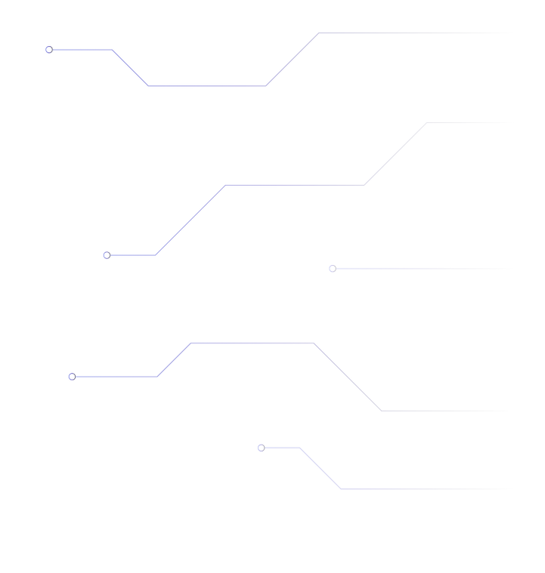
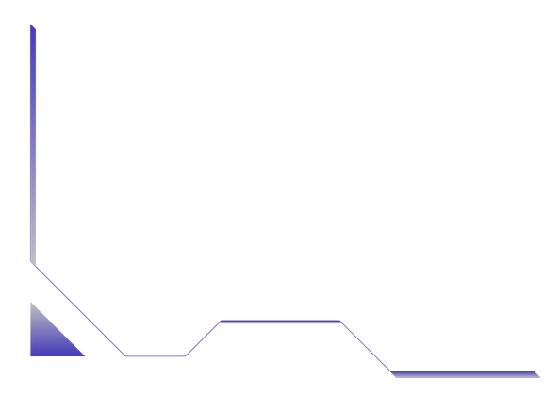
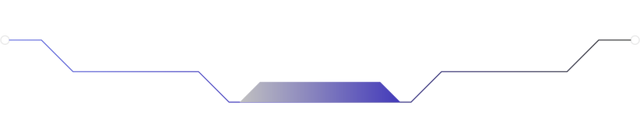


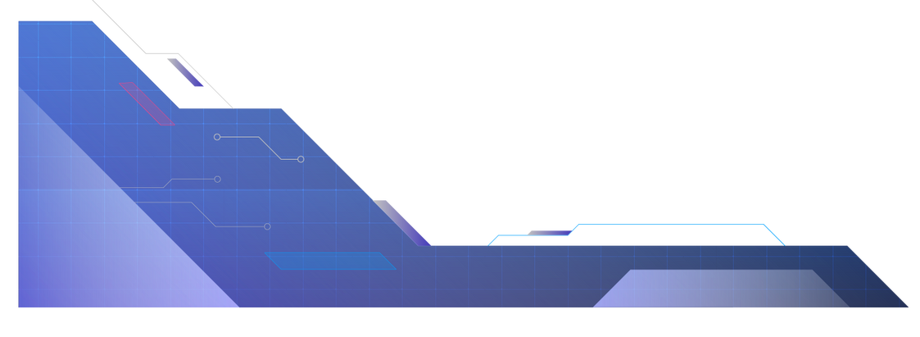
Flood-fill algorithm in a maze solving robot
Made by: Juan Diego Cabrera Moncada

Slide 2

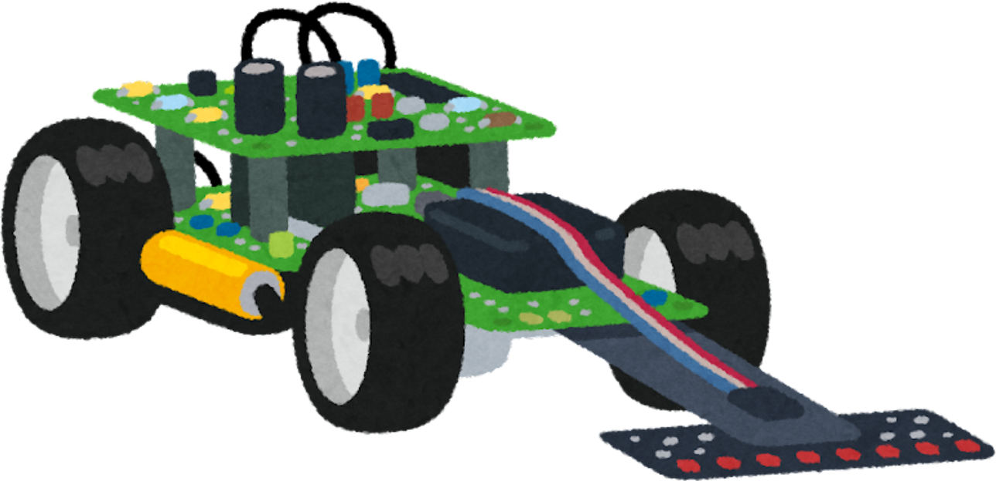

Introduction
Cuchau
Robot
Juan Diego
Cabrera Moncada
Student
Department of Electronic and Telecommunications Engineering

Slide 3






Motivation
Shortest Path Algorithm Research
Efficiency
Maze solving as an application problem
Short time solving mazes
Recursiveness
Autonomous navigation
Feedback analysis
Sensor data management
Decision making on path to take
Adjustments on robot’s pathing based on known data and new info

Slide 4
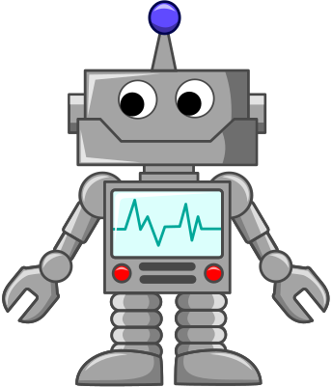
Problem statement
Representation of initial data
Sensor usage
Flood - fill algorithm implementation (Feedback info.)
Pathing decision making
Hardware configuration

Slide 5

Materials
ACTUATORS | 4 DC motors, each with one wheel connected.
SENSORS | 3 ultrasonic sensors (HC-SR04)
MECHANICAL STRUCTURE | Chasis of the robot and terminal block shield
POWER SOURCE | 9v battery and 3 rechargable batteries of 3.7v
MICROCONTROLLER | Arduino Nano
DRIVER | L298N module controlled via digital signals and PWM

Slide 6
Methods
01
02
Data initialization
Physical Model Construction
Maze 2D representation
Robot’s position and target
Sensors data parametrization
Pin assignment
Motor speed initialization
Structure of the robot
Location of sensors and actuators
03
04
Modules for data acquisition
Modules for robot’s control
Enabling sensors readings
Data updating based on sensors
Flood - fill algorithm
Rotation and movement of the robot
Robot’s position update and goal checking

Slide 7
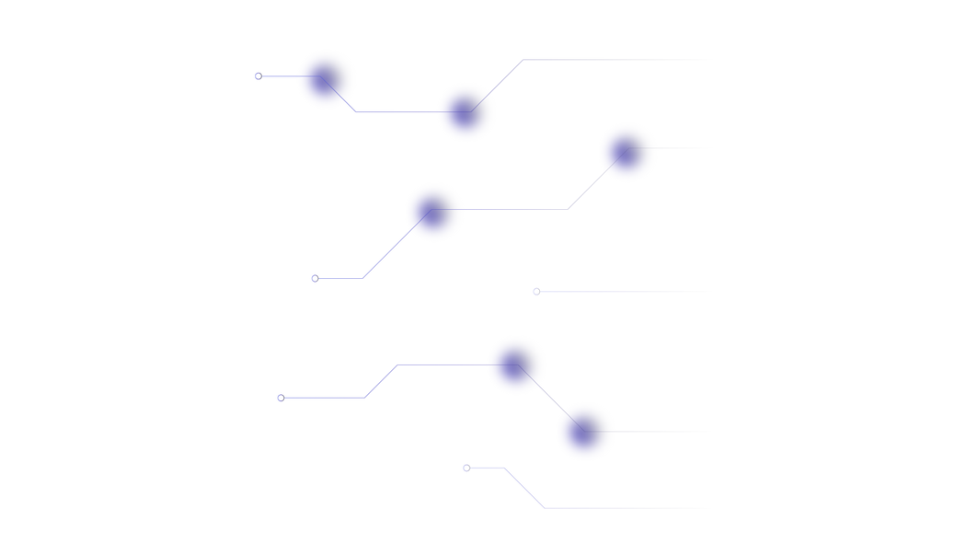
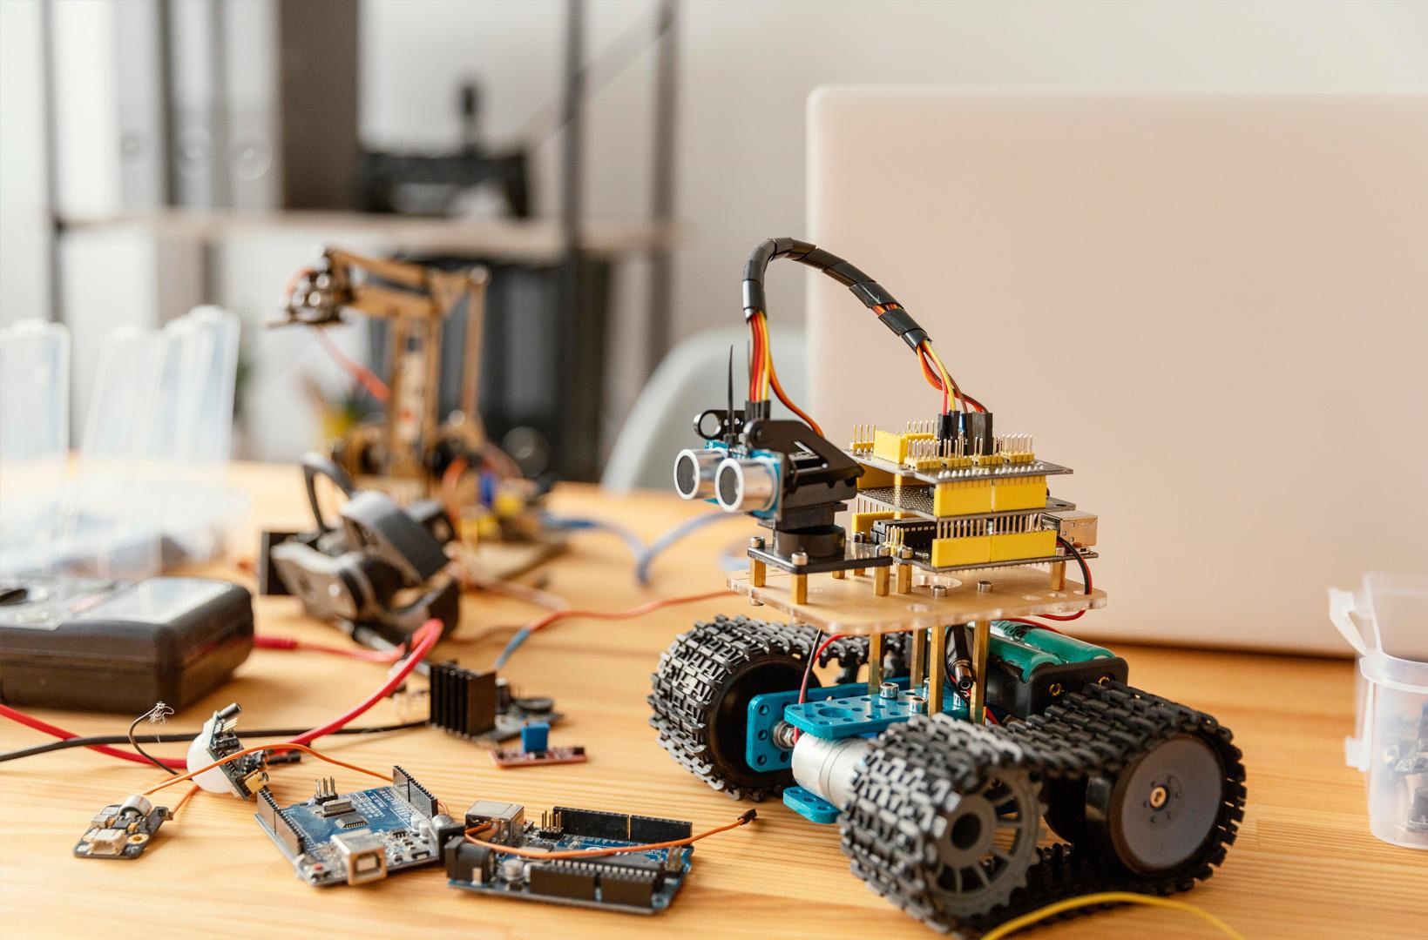
Results and Discussion

Slide 8
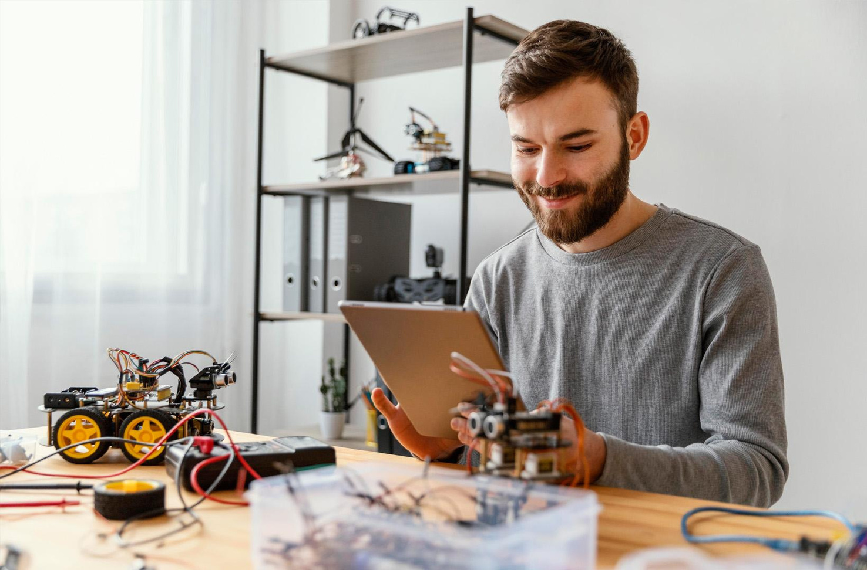
Results
Bilder zeigen große Datenmengen, also denke daran: verwende ein Bild statt eines langen Textes
Discussion
Bilder zeigen große Datenmengen, also denke daran: verwende ein Bild statt eines langen Textes

Slide 9
Conclusions
1
1
3
4

Slide 10



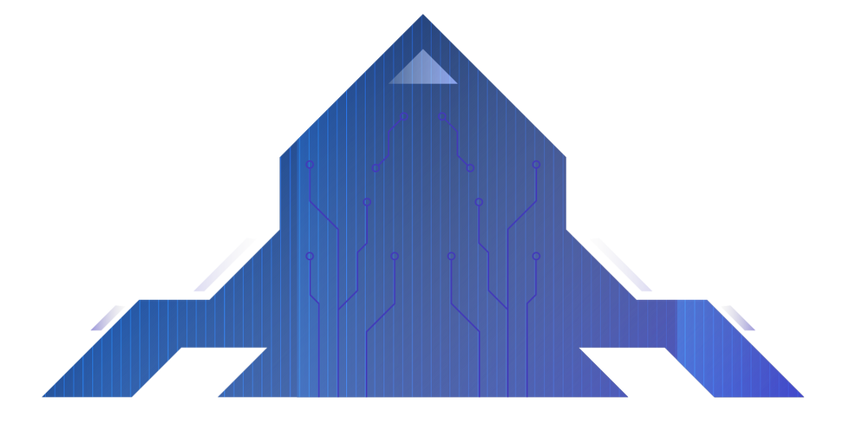
Future Work
MERKUR
VENUS
JUPITER
Merkur ist der sonnennächste Planet und der kleinste von allen
Die Venus ist der zweite Planet des Sonnensystems und der drittkleinste
Jupiter ist ein Gasriese und der größte Planet in unserem Sonnensystem

Slide 11
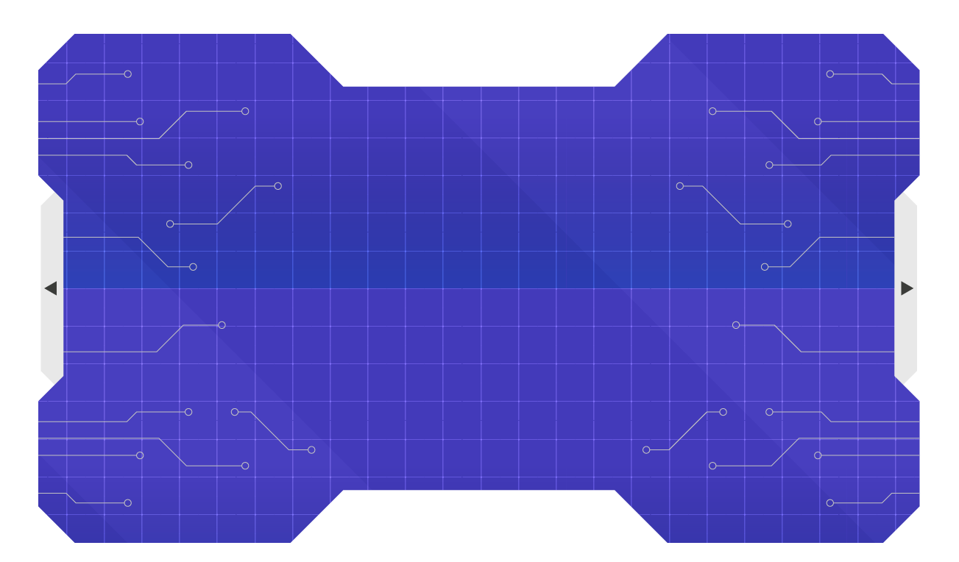
THANKS!

Slide 12









































ICON PACK

